Slide 1
History of C-Language
Developed by Dennis M.Ritchie and Brian Kernighan of AT&T Bell Labs in 1972.
In 1983 the American National Standards Institute began the standardization process ( ANSI).
In 1989 the International Standards Organization continued the standardization process (ISO)
Systems programming language
C is a procedural language.
C is a case sensitive language.
C is a function oriented language.

Slide 2
Components of a C Program
A C program is a collection of function definitions, (global) variable definitions, declarations and compiler directives.
Functions ( e.g., void push( char c ) { … } )
Variables ( e.g., int top; char Store[MAX]; )
Declarations ( e.g., void push( char c ); )
Compiler directives ( e.g., #define MAX 100 #include <stdio.h> )

Slide 3
Why teach C?
C - is small (only 32 keywords).
C - is common (lots of C code about).
C - is stable (the language doesn’t change much).
C - is quick running.
C - is the basis for many other languages (Java,C++,awk,Perl).
C - is one of the easiest languages to learn.
C - is a Procedure Oriented Language.
C - is a Function Oriented Language.
C - is a Case Sensitive Language.
C – is a Syntax Oriented Language
C – is a Structured Programming Language

Slide 4
Dangers of C
Memory management is left to you (unlike Java, C#, scripting, Visual Basic)
Explicit initialization and error detection left to you
Generally, you have to write more lines of code for the same functionality
Easy to make mistakes that the compiler won’t catch
Language is portable, but libraries and APIs are not
No easy graphics interface.
C is not "safe"
  It assumes you know what you're doing
  It has a lot of scope for bugs.

Slide 5
C-Language
Strengths:
Efficiency
Portability - (A measure of system independence i.e. without modify program we can run another system).
Powerful Language
Flexibility - (the property of being flexible)
Standard Library.
Integration with UNIX,LINUX and Windows.
Weaknesses:
1. C programs can be error-prone.
2. C programs can be difficult to understand
3. C programs can be difficult to modify.

Slide 6
Characteristics of C
C is standardized (ANSI C).
C is ubiquitous (widely present)
C is a low-level language
C is a small language
C - is easy to learn.
C - programs are fast.
C - programs are concise - (expressing much in few words).
C - compilers---programs that translate C programs into machine instructions---are usually fast and concise.
Unix, a popular operating system, happens to be written in C.

Slide 7
The Benefits And Pitfalls Of C
Benefits
It’s a powerful language (doesn’t restrict you)
Fast programming language
A practical language (real applications)
Pitfalls
It’s a powerful language (No programmer fail-safes)
Compiled code is not portable

Slide 8
Compiling and Linking
1.Preprocessing. The program is first given to a preprocessor, which obeys commands that begin with # (known as directives). #include <stdio.h> (include the info in <stdio.h> before compiling).
2. Compiling. The modified program now goes to a compiler, which translates it into machine instructions (object code).
3. Linking. A linker combines the object code produced by the compiler with any additional code needed to yield a complete executable program.
test.c ---> (compiled) ---> test.obj (linked) ---> executable file.

Slide 9
Some programmer jargon
  Source code: The stuff you type into the computer. The program you are writing.
  Compile (build): Taking source code and making a program that the computer can understand.
  Executable: The compiled program that the computer can run.
  Language: (Special sense) The core part of C central to writing C code.
  Library: Added functions for C programming which are bolted on to do certain tasks.
  Header file: Files ending in .h which are included at the start of source code.

Slide 10
Contd….
Compiler:
  Translates program written in "source" language to "target" language.
Interpreter:
  Translate and immediately execute
Assembler:
  Translate into machine language for particular machine
Macro Processor:
  Textual substitutions

Slide 11
Some Key Terminology
Source Program
  printable/Readable Program file
Object Program
  nonprintable machine readable file
Executable Program
  nonprintable executable code
Syntax errors
  reported by the compiler
Linker errors
  reported by the linker
Execution/Run-time errors
  reported by the operating system

Slide 12
C - Character Set
Letters (upper case and lower case)
A B C D E F G H I J K L M
N O P Q R S T U V W X Y Z
a b c d e f g h i j k l m
n o p q r s t u v w x y z
Digits
0 1 2 3 4 5 6 7 8 9
Special Characters: space (also known as blank)
’ " ( ) * + - / : =
! & $ ; < > % ? , .
ˆ # @ ˜ ‘ { } [ ] \ |

Slide 13
Character Literals
Single key stroke between quote char ‘
Examples: ‘A’, ‘a’, ‘b’, ‘1’, ‘@’
Some special chars: Escape Sequences
  \0 - null character
  \n – New line Character
  \t - tab char
  \r – Carriage Return
  \ - single quote char
  \\ - backslash char

Slide 14
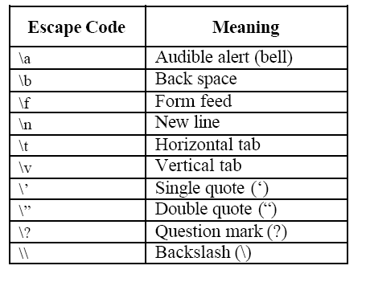
Escape Codes (or) Sequences

Slide 15
Structure Of A C Program
Example – program.c
/* Program documentation */
#Preprocessor directives
Global constants
Global variables
Function prototypes
main ()
{
}
Local variables
Function definitions

Slide 16
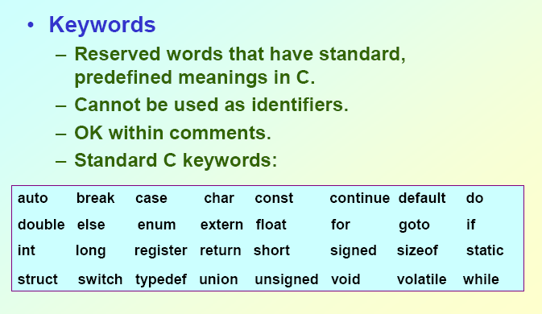

Slide 17
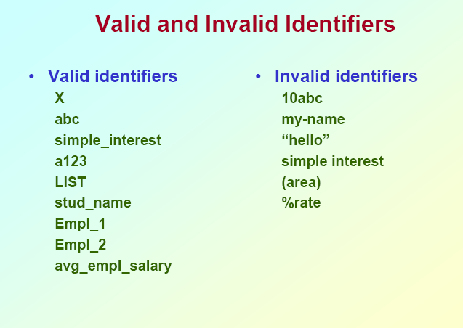

Slide 18
1 ) Write a C-program to determine the ranges of char , short , int , and long variables, both signed and unsigned .
#include <stdio.h>
#include <limits.h>
main ()
{
printf("Size of Char %d\n", CHAR_BIT); printf("Size of Char Max %d\n", CHAR_MAX); printf("Size of Char Min %d\n", CHAR_MIN); printf("Size of int min %d\n", INT_MIN); printf("Size of int max %d\n", INT_MAX); printf("Size of long min %ld\n", LONG_MIN);

Slide 19
printf("Size of long max %ld\n", LONG_MAX);
printf("Size of short min %d\n", SHRT_MIN);
printf("Size of short max %d\n", SHRT_MAX);
printf("Size of unsigned char %u\n", UCHAR_MAX);
printf("Size of unsigned long %lu\n", ULONG_MAX);
printf("Size of unsigned int %u\n", UINT_MAX);
printf("Size of unsigned short %u\n", USHRT_MAX);
getch();
}

Slide 20
/*Program to find the feet to Inches*/
#include <stdio.h>
main(void)
{
int feet;
clrscr();
printf(“Enter Feet value:”);
scanf(“%d”, &feet);
inches = feet * 12;
printf(”%d feet = %d inches”, feet, inches);
return 0;
}
    Input : 6
    Output :72

Slide 21
Flowchart for hello_world.c
An oval denotes either the start or the end of the program, or a halt operation within the program (which we’ll learn about later).
A parallelogram denotes either an input operation or an output operation.
An arrow denotes the flow of the program.
int main ()
{
printf("Hello, world!\n");
}
Start
Output “Hello, world!”
End

Slide 22
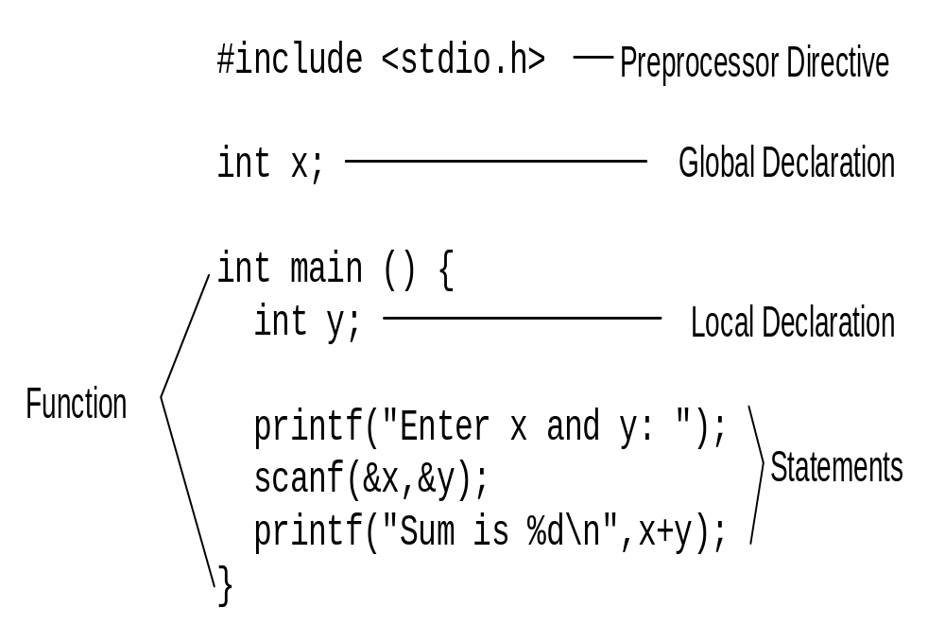
Parts of a Program

Slide 23
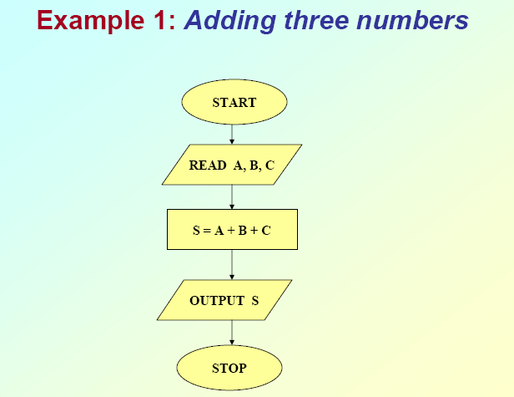

Slide 24
Hello World Program
#include <stdio.h> // input-output library
int main() // function main
{
printf(”Hello World\n”); // send string to standard output
return 0;
}
Compile the source file helloworld.c with the command

Slide 25
Compilation & Linking
header file
source file
helloworld.c
stdio.h
#include <stdio.h>
compiler
object file
helloworld.o
linker
helloworld
executable file

Slide 26
Program for Convert Fahrenheit to Celsius
#include <stdio.h>
int main(void)
{
int fahr = 42, cels;
cels = 5*(fahr-32)/9;
printf("%d degrees Fahrenheit is %d degrees Celsius\n", fahr, cels);
return 0;
}

Slide 27
/*uses scanf() to get input*/
#include <stdio.h>
int main(void)
{
int fahr, cels;
printf("How many degrees? ");
scanf("%d", &fahr);
cels = 5*(fahr-32)/9;
printf("%d degrees Fahrenheit is %d degrees Celsius\n", fahr, cels);
return 0;
}

Slide 28
Program for number of secs in a day
#include <stdio.h>
int main()
{
int secs, hours, minutes;
hours = 24;
minutes = 60;
secs = hours * minutes * 60 ;
printf("The number of secs in a day =%d\n", secs);
return 0;
}

Slide 29
/* Perform some calculations. */
#include <stdio.h>
main()
{
float x, y;;
printf ("Enter two numbers\n");
scanf ("%f%f", &x, &y);
printf("%f + %f = %f\n", x, y, x+ y);
printf("%f - %f = %f\n", x, y, x+ y);
printf("%f * %f = %f\n", x, y, x * y);
printf("%f / %f = %f\n", x, y, x / y);
printf(“%f %% %f = %f\n”, x, y, x%y);
getch();
}

Slide 30
/* Perform some calculations. */
#include <stdio.h>
main()
{
int a, b;
printf("Enter two integers\n");
scanf("%d%d", &a, &b);
printf("%d + %d = %d\n", a, b, a+ b);
printf("%d - %d = %d\n", a, b, a - b);
printf("%d * %d = %d\n", a, b, a * b);
printf("%d / %d = %d\n", a, b, a / b);
printf("%d %% %d = %d\n", a, b, a % b);
getch();
}

Slide 31
/*Addition program */
#include<stdio.h>
main()
{
int integer1,integer2,sum;
printf("Enter first integer:\n");
scanf("%d",&integer1);
printf("Enter second integer:\n");
scanf( "%d",&integer2 );
sum = integer1+integer2;
printf( "Sum is %d\n”,sum );
getch();
}

Slide 32
1.Write a C-Program for adding two numbers
#include <stdio.h>
main()
{
int a, b, result;
clrscer();
printf(“Enter input data a,b:“);
scanf(“%d,%d“,&a,&b);
result=a+b;
printf(“Result=%d \n“, result);
getch();
}
INPUT : 2, 3
OUTPUT : 5

Slide 34
Write a C-Program to solve the Expressions
#include<stdio.h>
#include<math.h>
main()
{ int a,b,y,result;
printf(“Enter the Values of a,b,x,y:”);
scanf(“%d%d%d%d”, &a,&b,&x,&y);
result=(a*x + b) / (a*x – b);
printf(“Result of (a*x+b)/(a*x-b)=%d\n”,result);
result=(10*x+25*)/(x-1);
printf(“Result of (10*x+25*y)/(x-1)=%d\n”,result);
result=pow(x,5)+2*pow(x,4)+3*pow(x,2)+4*x+20;
printf(“Result=%d”,result);
getch();
}

Slide 35
/*Program for print the different data types*/
#include <stdio.h>
main()
{ int a;
double x;
char c;
printf(“Enter integer:”);
scanf(“%d”, &a);
printf(“\n Enter double:”);
scanf(“%lf”, &x);
printf(“\n Enter character:”);
scanf(“%c”, &c);
printf(“\n The value of a is %d, of x is %lf, of c is %c\n”, a, x, c);
}

Slide 36
  WAP to read values and print same values
  #include <stdio.h>
int main()
{ char c1, c2, c3;
int i;
float x;
double y;
printf("Input three characters\n an int, a float, and a
double:\n ");
scanf("%c%c%c%d%f%lf", &c1, &c2, &c3, &i, &x, &y);
printf("\n Here is the data that you typed in:\n");
printf("%c%c%c%d%lf%lf\n\n", c1, c2, c3, i, x, y);
}

